Slide 1
DA Form 2166-9 Series
Module 3: NCOER Support Form & Grade Plate NCOERs
as of 10 July 2015
Notes:
Good Morning/Afternoon, my name is ___________________________ and I work in _____________________ as a/the____________________________.
During this block of instruction, I will provide detailed information on the DA Form 2166-9 series, which includes the NCOER Support Form and the three grade plate NCOERs. I will cover the key form changes, as well as provide clarification for the definitions and descriptions for the leader attributes and competencies and Rater and Senior Rater box scale. If you have questions during the brief, please feel free to ask them.
NEXT SLIDE

Slide 2
Agenda
What is Changing on the NCOER
NCOER Support Form
Grade Plate NCOER
Part I – Administrative Data
Part II – Authentication
Part III – Duty Description
Parts IVa and IVb – APFT and HT / WT
Army Leadership
Performance Measures
“FAR EXCEEDED STANDARD”
“EXCEEDED STANDARD”
“MET STANDARD”
“DID NOT MEET STANDARD”
Notes:
Here’s the agenda and the following key areas I will discuss:
What is changing on the NCOER
DA Form 2166-9 Series and the parts of each form
Leader Attributes and Competencies
Performance Measures
NEXT SLIDE

Slide 3
Agenda (cont.)
Part IV – Rater Assessment
Character
Direct-level Report (SGT)
Organizational-level Report (SSG-1SG/MSG)
Strategic-level Report (CSM/SGM)
Potential Measures
“MOST QUALIFIED”
“HIGHLY QUALIFIED”
“QUALIFIED”
“NOT QUALIFIED”
Part V – Senior Rater Assessment
Direct-level Report (SGT)
Organizational- and Strategic-level Reports (SSG through CSM/SGM)
Notes:
In addition, I’ll also discuss the rater and senior rater assessments for each form and the senior rater potential measures.
NEXT SLIDE

Slide 4
What is Changing on the NCOER
Characteristic | Current NCOER (DA Form 2166-8) | New NCOER (DA Form 2166-9 Series)
NCOER Support Form | Based on the Leadership Dimensions of FM 22-100 Rater counsels initially and quarterly Senior rater – no requirement to counsel Reviewer – no requirement to counsel; provides oversight/assists rating chain | Aligns with Leadership Requirements Model of ADP 6-22 Rated NCO provides goals and expectations Rater counsels initially and quarterly Senior rater should counsel twice during rating period Supplementary reviewer, as required Incorporates SSD/NCOES completion box for next grade
Form | One report for all NCOs | Three reports SGT (Direct) SSG through 1SG/MSG (Organizational) CSM/SGM (Strategic)
Rating Chain Responsibilities | Rater assesses performance and potential Senior rater assesses performance and potential Reviewer provides oversight/assists rating chain | Rater assesses performance Senior rater assesses potential Supplementary reviewer, as required
Army Leadership Doctrine | Based on Leadership Dimensions of FM 22-100 | Aligns with Leadership Requirements Model of ADP 6-22
Assessment Format | Bullet comments for all NCOs | Rater Bullet comments for SGT through 1SG/MSG Narrative comments for CSM/SGM Senior rater – narrative comments for all NCOs
Senior Rater Assessment | Uncontrolled promotion-based “1” – Recommendation for immediate promotion “2” – Strong recommendation for promotion “3” – Recommendation for promotion “4” – Should not be promoted at this time “5” – Do not promote | Controlled potential-based “MOST QUALIFIED” (limited to 24%) “HIGHLY QUALIFIED” “QUALIFIED” “NOT QUALIFIED”
Rating Chain Accountability | No accountability | Rater tendency and constrained senior rater profile for SSG through CSM/SGM
Notes:
Here is a comparison chart of the current NCOER and the New NCOER.
As you can see, the New NCOER Support Form aligns with current doctrine, ADP 6-22; whereas the current NCOER is based on outdated doctrine. The DA 2166-9 now has an entry for the rated NCO to provide their goals and expectations for that rating period. The support form also incorporates an SSD/NCOES completion box for the next grade so that the rater and senior rater may track the progress of the NCO’s Military Education Level and attaining promotion eligibility.
Three reports were developed for the levels of leadership, based on grade and scope of responsibility. The first NCOER form, which is referred to as the direct-level report is for NCOs in the rank of SGT. This form is developmental in nature. At this level, junior NCOs are refining the ability to apply competencies at a proficient level. The organizational-level form is for SSG through MSG; it focuses on organizational systems and processes. In this level of leadership, NCOs apply competencies to increasingly complex situations. The last form is the strategic-level report for CSM/SGM. At the strategic level, leaders shape the military through change over extended time.
There is a clear delineation between the rater and senior rater responsibilities. The rater will assess performance only and the senior rater will assess potential. The senior rater will also assume the role/responsibility of reviewer. The role of supplementary reviewer has been added and there are certain cases when a supplementary review is required.
The assessment format has also changed as the senior rater comments will be written in narrative format and the entire assessment for CSM/SGM will be written in narrative comments.
The new NCOER is designed to reduce inflation and this will be accomplished through the controlled potential-based senior rater assessment and also by incorporating a rater tendency label and a managed senior rater profile for SSG through CSM/SGM.
NEXT SLIDE

Slide 5
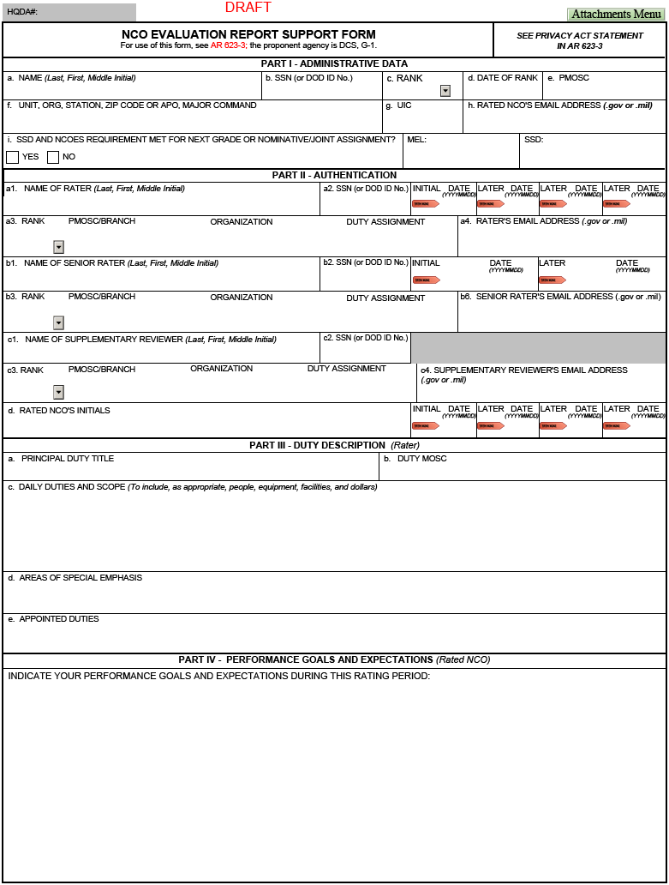
NCOER Support Form – Page 1
Part I – SSD and NCOES requirement met for next grade
Part II – Senior rater should counsel the rated NCO, at a minimum, twice during rating period
Part II, block c – Supplementary reviewer, as required
Part IV – Rated NCO provides goals and expectations
Up to 7 lines of text
Up to 2 lines of text
Up to 2 lines of text
Up to 16 lines of text
Notes:
As mentioned on the previous slide, DA Form 2166-9-1A, the NCOER Support Form, will align with Army leadership doctrine. In addition, the rated NCO’s current Military Education Level (MEL) and Structured Self Development (SSD) codes will be included on the form. This will enable the rating officials to mentor and counsel the rated NCO and track his/her progress in attaining promotion eligibility for the next grade. In the case of Sergeants Major, eligibility for joint and/or nominative assignments.
Another key change is the ability for the senior rater to counsel the rated NCO twice during the rating period and document it on the NCOER Support Form. This will complement the rater’s initial and quarterly counseling session. Also, with the implementation of a senior rater profile, it becomes more critical for the senior rater to provide counsel and mentorship to the rated NCO.
In Part IV, the rated NCO will list their goals and expectations. This change gives the rated NCO input about goals and expectations but will also place more onus or responsibility on the rated NCO to perform throughout the rating period. The information provided gives the rating officials additional information to consider when evaluating overall performance and potential at the end of the rating period.
NEXT SLIDE

Slide 6
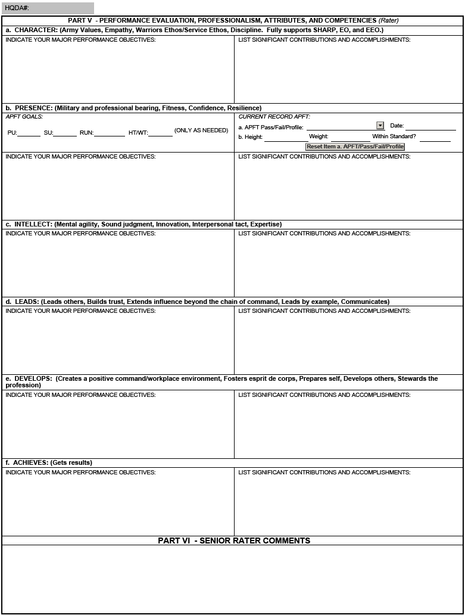
NCOER Support Form – Page 2
Part V – Attributes and Competencies (ADP 6-22)
Part VI – Senior rater provides comments.
Up to 8 lines of text for each field
Notes:
As mentioned, the NCOER Support Form does capture the attributes and competencies from ADP 6-22.
In Part V, in the left column, the rater will identify the major performance objectives based on the attributes and competencies listed in ADP 6-22. In the right column, the rater can list the rated NCO’s contributions or accomplishments – these comments can help provide the basis for the NCOER itself.
In Part VI, the senior rater will be able to provide comments based on counseling sessions conducted with the rated NCO.
NEXT SLIDE

Slide 7
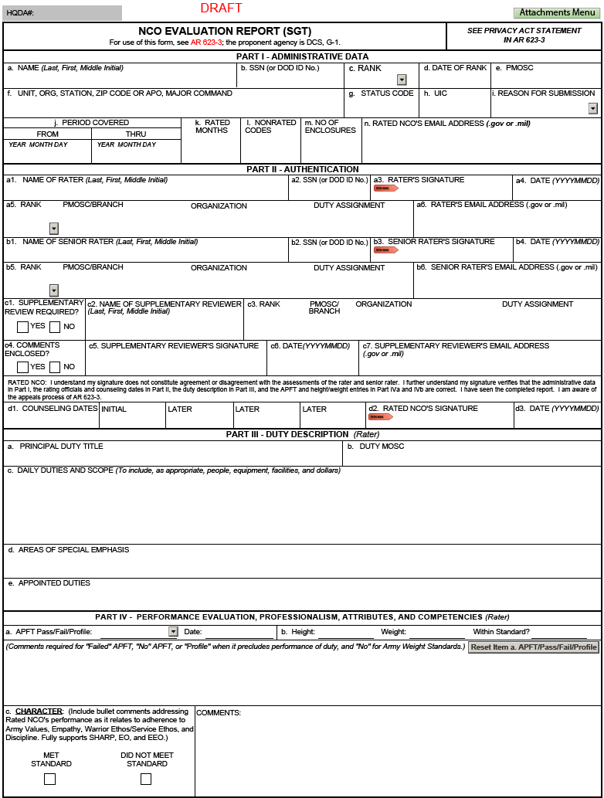
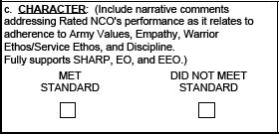
Grade Plate NCOER – Page 1
Front page – same for all
grade-plate forms
Part II, block c – Supplementary reviewer, as required
Part IV, blocks a and b – APFT and HT/WT
Up to 7 lines of text
Up to 5 lines of text
Bullet comments for all grade plates except Strategic Report (CSM/SGM)
Notes:
The next several slides are screenshots of the draft grade plate NCOERs, broken down by section. As for the front page, it is the same for all three forms with the exception of the DA Form 2166-9-3 (CSM/SGM), which will be written in narrative comments.
NEXT SLIDE

Slide 8
Part I – Administrative Data
DOD ID Number will be the primary number utilized; SSN should only be used if DOD ID Number is not available
Must ensure the Unit Identification Code (UIC) is entered correctly to retrieve data in the Evaluation Reporting System (ERS)
Notes:
In support of the Department of Defense’s initiative to discontinue the use of Social Security Numbers, the 10-digit DOD ID Number (located on the back of the Common Access Card (CAC)) will be utilized versus the rated NCO’s SSN.
Rated NCOs, rating officials, and delegates must ensure that UICs are entered correctly in Part I, block h. If the UIC is entered incorrectly, the reporting database, Evaluation Reporting System (ERS), will not be able to retrieve information for that invalid UIC. Like IWRS, ERS is the status reporting database for all evaluations processed in the Evaluation Entry System (EES).
During a rated Soldier lookup, if the UIC is incorrect, then contact your unit S1 to update the database of record (usually EMILPO). You can overwrite the information on the NCOER, however, it will not correct the main database.
Remember if you use the NCOER Support Form in the online system, all of the admin information entered on the form will auto-populate the NCOER when it is created from the support form.
(This is key to data accuracy in the Evaluation System process.)
NEXT SLIDE

Slide 9
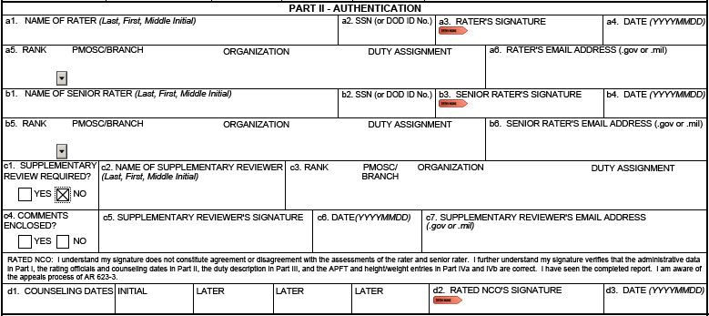
Part II – Authentication
DOD ID Number will be the primary number utilized; SSN should only be used if DOD ID Number is not available
Use Enterprise email address
If a supplementary review is not required, then the user will select “NO” in Part II, block c1 and leave the remaining section blank
Rated NCO’s signature will verify the accuracy of administrative data in Part I, the rating officials and counseling dates in Part II, the duty description in Part III, and the APFT and HT/WT entries in Part IV
Notes:
DOD ID Numbers will be utilized for rating officials as well. If DOD ID Numbers are not available, then the SSN will be used. An example of this is when a rating official does not have a DOD-issued CAC (e.g., rating officials who work for the State Department and Congress.)
AKO email addresses will not be entered on the form, use DOT GOV or DOT MIL.
As mentioned before, the senior rater will be perform the review unless a supplementary review is needed. If a supplementary review is not required, then the user will select “NO” in Part II, block c1 and leave the remaining section blank.
If the Uniformed Army Advisor determines comments are necessary, he or she will select “YES” in Part II, block c4 of the NCOER and prepare an enclosure to the NCOER which will address the accuracy and clarity of the completed NCOER. Note: The comments will not include evaluative statements about the rated NCO or statements that amplify, paraphrase, or endorse the ratings of the other members of the rating chain.
The rated NCO’s signature will verify the accuracy of the administrative data in Part I, confirming the name and SSN on the evaluation report, rank and date of rank, branch or MOS data, period covered and nonrated time; the rating officials and counseling dates in Part II; the duty description in Part III, and the APFT and height and weight entries in Part IV. This procedure ensures that the rated NCO has seen the completed evaluation report. It also increases the administrative accuracy of the evaluation report and will normally preclude an appeal by the Rated NCO based on inaccurate administrative data.
Remember if you use the NCOER Support Form in the online system, all of the admin information entered will auto-populate the NCOER when it is created from the support form.
NEXT SLIDE

Slide 10
Part III – Duty Description
Up to 7 lines of text
Up to 2 lines of text
Up to 2 lines of text
Rater will annotate the following:
Principal duty title
Duty MOSC
Daily duties and scope
Areas of special emphasis
Appointed duties
Notes:
The duty description is comprised of five sections in Part III:
The first section, Part III, block a, is the principal duty title. The duty title will parallel the duty title shown on the NCOER Support Form.
The next section, Part III, block b, is the duty MOSC. The duty military occupational specialty code (MOSC) (at least five characters but no more than nine) that coincides with the duty title will be entered. In cases where the rated NCO is filling an officer position, enter the enlisted MOSC that best matches the officer position.
The third section, Part III, block c, is a description of the daily duties and scope – the user will enter the most important routine duties and responsibilities. Unless changes occurred during the rating period, the duty description on the NCOER should be the same as the one on the NCOER Support Form. (Note: Written in a series of phrases, starting with action words, separated by semicolons, and ending in a period. Use present tense.)
The fourth section, Part III, block d, areas of special emphasis, is a list of tasks or duties that required top priority during the rating period such as SRP, UPL, or Master Resiliency. (Note: Separated by semicolons and ending in a period.)
The last section, Part III, block e, is the list of appointed duties. These are duties appointed to the NCO not normally included in the duty description. (Note: Separated by semicolons and ending in a period.)
Remember, if you complete the NCOER Support Form within EES, then all of the admin information will auto-populate the NCOER when it is created.
NEXT SLIDE

Slide 11
Part IVa and IVb – APFT and HT / WT
Up to 5 lines of text
Rater will enter the following:
APFT
PASS
FAIL
PROFILE
PREGNANT POST PARTUM
NO APFT
HT / WT (including compliance with AR 600-9)
Notes:
In Part IV, blocks a and b, the rater will enter the most recent record APFT administered by the unit (within the 12-month period to the “THRU” date of the NCOER) and the unit’s last record weigh-in data (including whether or not the rated NCO is in compliance with AR 600-9). Comments are mandatory for an APFT failure, ‘NO APFT,” a “PROFILE” that hinders duty performance, and a “NO” entry for height/weight compliance.
Remember if you use the NCOER Support Form in the online system, all of the admin information entered will auto-populate the NCOER when it is created within the Evaluation Entry System (EES).
NEXT SLIDE

Slide 12
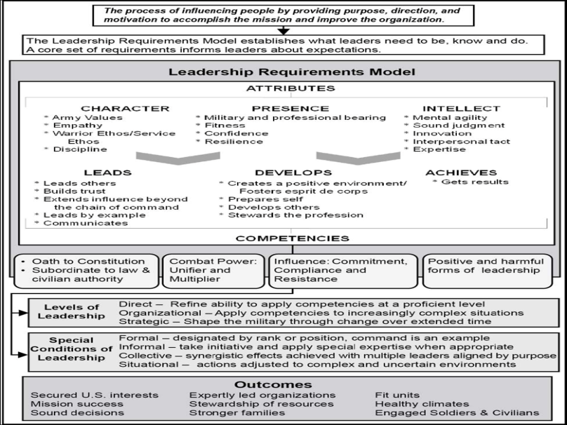
Army Leadership
Notes:
In Part IV of the three grade plate NCOERs, the rater will begin assessing the rated NCO on his/her attributes and competencies from Army Doctrine Publication (ADP) 6-22.
As defined in ADP 6-22, “Leadership is the process of influencing people by providing purpose, direction, and motivation to accomplish the mission and improve the organization.”
Based on this, the Leadership Requirements Model outlines the expectations that the Army wants leaders to meet. The attributes (CHARACTER, PRESENCE, and INTELLECT) are what leaders should be and know while the competencies (LEADS, DEVELOPS, and ACHIEVES) are what leaders should do.
In order to display effective leadership, the leader must blend the core leadership attributes (those characteristics inherent to the leader that moderates how well learning and performance occur) with competencies (groups of related leader behaviors that lead to successful performance and are common throughout the organization and consistent with the organization’s mission and value).
Leaders acquire competencies at the direct leadership level. As the leader moves to organizational and strategic level positions, the competencies provide the basis for leading through change. Leaders continuously refine and extend the ability to perform these competencies proficiently and learn to apply them to increasingly complex situation. Filtering these attributes and competencies through the levels of leadership be it direct, organizational, or strategic, allows the rater and senior rater to manage and set expectations for the rated NCO. When you look at the new grade plate NCOERs, you should note that they too are organized along this methodology and the expectations of a new SGT are not the same as those for a CSM/SGM. That is why we have changed from one (1) form to three (3) forms so that it is readily apparent how expectations change.
The outcomes listed are some of the expected results that happen when our Army and its leaders possess, develop, and apply strong attributes and competencies.
NEXT SLIDE

Slide 13
Attributes – What a Leader Is
Level | Character (Army Values, Empathy, Warrior Ethos / Service Ethos, Discipline, SHARP/EO/EEO) | Presence (Military and professional bearing, Fitness, Confidence, Resilience) | Intellect (Mental agility, Sound judgment, Innovation, Interpersonal tact, Expertise)
Direct (SGT) | Creates a climate that embraces Army Values; character is aligned with the Army’s expectations | Demonstrates good presence and confidence across expected duties of the position. | Conceptual capabilities, interpersonal tact, and domain knowledge are effective for direct level
Organizational (SSG – 1SG / MSG) | Exhibits behaviors that are clear outward expression that aligns personal character with Army expectations | Demonstrates excellent presence, confidence and resilience in expected duties and unexpected situations. | Conceptual capabilities, interpersonal tact, and domain knowledge are effective for operations at battalion and below
Strategic (CSM / SGM) | Demonstrates a sense of responsibility for the Army profession; character is of absolute integrity | Astutely manages complexity and anticipates transitions at strategic level; viewed as champions of causes, diplomats and ambassadors of high level interests. | Excels at complex thinking and multiple perspectives; adept with the Army design method; broad and deep understanding of history, world situations, technological possibilities, and dynamics of organizations.
*Based on Leader Development Strategy for a 21st Century Army, 25 Nov 09
Notes:
This attributes chart from the Center of Army Leadership (CAL) breaks out what is expected of a leader by level. You can see that the level of complexity and responsibility increases with rank. This illustrates the necessity for the three level-based NCOERs.
CHARACTER – Leadership is affected by a person’s character and integrity. Integrity is a key mark of a leader’s character. It means doing what is right, legally and morally, and is essential to successful leadership. (Army Values, Empathy, Warrior Ethos/Service Ethos, Discipline)
PRESENCE – The impression a leader makes on others contributes to success in getting people to follow. This impression is the sum of a leader’s outward appearance, demeanor, actions and words, and the inward character and intellect of the leader. (Military and professional bearing, Fitness, Confidence, Resilience)
INTELLECT – The leader’s intellect affects how well a leader thinks about problems, creates solutions, makes decisions, and leads other. (Mental agility, Sound judgment, Innovation, Interpersonal tact, Expertise)
NEXT SLIDE

Slide 14
Competencies – What a Leader Does
Level | Leads (Leads others, Builds trust, Extends influence beyond the chain of command, Leads by example, Communicates) | Develops (Creates a positive command / workplace environment, Fosters esprit de corps, Prepares self, Develops others, Stewards the profession) | Achieves (Gets results)
Direct (SGT) | Demonstrated troop leading procedures and employment of TTPs relevant to their unit. | Builds environment of teams and teamwork. | Directs and prioritizes tasks for Squad level and below.
Organizational (SSG – 1SG / MSG) | Demonstrated competence in resolving complex situations. | Proactive in developing others through individual coach, teach and mentor subordinates; accurately and fairly assess, identifies future leaders. | Demonstrates ability to lead through complexity and time, decentralized operations and ill-structured problems. Prioritizes limited resources to accomplish mission.
Strategic (CSM / SGM) | Sets vision for operational and strategic level operations. | Creates systems and adopts policies supporting professional and personal growth across the organization. Stewards the Army’s interest in caring for and managing people and other resources. | Demonstrates ability to develop and describe broad vision and framework. Organizes, resources, integrates and aligns efforts among organizations to achieve mission goals.
*Based on Leader Development Strategy for a 21st Century Army, 25 Nov 09
Notes:
This competencies chart from the Center of Army Leadership (CAL) breaks out what is expected of a leader by level. You can see the level of expectations increases as Leaders progress through their career. This further illustrates the necessity for the three level-based NCOERs.
LEADS – Leaders motivate, inspire, and influence others to take initiative, work toward a common purpose, accomplish critical tasks, and achieve organizational objectives. Influence focuses on compelling others to go beyond their individual interests and to work for the common good. (Leads others, Builds trust, Extends influence beyond the chain of command, Leads by example, Communicates)
DEVELOPS – Leaders encourage and support others to grow as individuals and teams. They facilitate the achievement of organizational goals through helping others to develop. They prepare others to assume new positions elsewhere in the organization, making the organization more versatile and productive. (Creates a positive command / workplace environment, Fosters esprit de corps, Prepares self, Develops others, Stewards the profession)
ACHIEVES – A leader’s ultimate purpose is to accomplish organizational results. A leader gets results by providing guidance and managing resources, as well as performing the other leader competencies. Gets results focuses on consistent and ethical task accomplishment through supervising, managing, monitoring, and controlling the work. (Gets results)
NEXT SLIDE

Slide 15
Performance Measures
Organizational- and Strategic-level (SSG through CSM/SGM)
Direct-level (SGT)
FAR EXCEEDED STANDARD | EXCEEDED STANDARD | MET STANDARD | DID NOT MEET STANDARD
Rated NCO performs extraordinarily above the required Army standards and organizational goals of leader competencies and attributes; leadership enables Soldiers and unit to far surpass required organizational and Army standards; demonstrated performance epitomizes excellence in all aspects; this NCO and his/her Soldiers consistently take disciplined initiative in applying leader competencies and attributes; results have an immediate impact and enduring effect on the mission, their Soldiers, the unit, and the Army; demonstrated by the best of the upper third of NCOs of the same grade. | Rated NCO performs above the required Army standards and organizational goals of leader competencies and attributes; this NCO and his/her Soldiers often take disciplined initiative in applying leader competencies and attributes; results have an immediate impact on the mission, their Soldiers, the unit, and the Army; this level of performance is not common, typically demonstrated by the upper third of NCOs of the same grade. | Rated NCO successfully achieves and maintains the required Army standards and organizational goals of leader competencies and attributes; effectively meets and enforces the standard for the unit and those in his/her charge; succeeds by taking appropriate initiative in applying the leader competencies and attributes; results have a positive impact on the mission, their Soldiers, the unit, and the Army; this level of performance is considered normal and typically demonstrated by a majority of NCOs of the same grade. | Rated NCO fails to meet or maintain the required Army standards and organizational goals of leader competencies and attributes; does not enforce or meet the standard for the unit or those in his/her charge; exhibits/displays minimal or no effort; actions often have a negative effect on the mission, their Soldiers, the unit, and the Army.
Notes:
When the rater assesses the rated NCO’s performance based on the attributes and competencies of ADP 6-22, he/she will use the following performance measures:
“FAR EXCEEDED STANDARD”
“EXCEEDED STANDARD”
“MET STANDARD”
“DID NOT MEET STANDARD”
Note: The direct-level report for Sergeant will only use “MET STANDARD” and “DID NOT MEET STANDARD.” The organizational- and strategic-level Reports will use all four performance measures.
We’ll now discuss each performance measure on the following slides.
NEXT SLIDE

Slide 16
FAR EXCEEDED STANDARD
(applies to Organizational- and Strategic-level NCOERs)
FAR EXCEEDED STANDARD
Rated NCO performs extraordinarily above the required Army standards and organizational goals of leader competencies and attributes; leadership enables Soldiers and unit to far surpass required organizational and Army standards; demonstrated performance epitomizes excellence in all aspects; this NCO and his/her Soldiers consistently take disciplined initiative in applying leader competencies and attributes; results have an immediate impact and enduring effect on the mission, their Soldiers, the unit, and the Army; demonstrated by the best of the upper third of NCOs of the same grade.
o placed 1st of 23 teams in the recent LTG David E. Grange Jr. Best Ranger Competition
o nominated and selected over 11 senior NCOs to serve as the Army Corrections Command Operations Sergeant
o selected as the Secretary of the Army Career Counselor of the Year; incomparable retention knowledge
o expertly led his/her SGLs to earn an Institute of Excellence rating within eight months of arrival
o selected by Corps/Division G-1 as the best Brigade S-1 within area of responsibility
Notes:
“FAR EXCEEDED STANDARD” is defined as a rated NCO who performs extraordinarily above the required Army standards and organizational goals of leader competencies and attributes. This is typically demonstrated by the best of the upper third of NCOs of the same grade. This performance measure is used in rare or very unique instances. The following examples were identified by TRADOC and the proponents.
NEXT SLIDE

Slide 17
EXCEEDED STANDARD
(applies to Organizational- and Strategic-level NCOERs)
EXCEEDED STANDARD
Rated NCO performs above the required Army standards and organizational goals of leader competencies and attributes; this NCO and his/her Soldiers often take disciplined initiative in applying leader competencies and attributes; results have an immediate impact on the mission, their Soldiers, the unit, and the Army; this level of performance is not common, typically demonstrated by the upper third of NCOs of the same grade.
o mentored two squad members to be inducted into the Sergeant Audie Murphy Club
o graduated from M1A2/MGS/Bradley Master Gunner’s Course
o scored 2+/2+ on the Defense Language Proficiency Test (DLPT); surpassed Army standard in a Category IV language
o recognized with the Military Outstanding Volunteer Service Medal for volunteering over 100 hours with local community
o selected over eight seniors and 15 peers by the Deputy Commanding General to serve as Master Driver
Notes:
“EXCEEDED STANDARD” is defined as a rated NCO who performs above the required Army standards and organizational goals of leader competencies and attributes. This is typically demonstrated by the upper third of NCOs of the same grade. The following examples were identified by TRADOC and the proponents.
NEXT SLIDE

Slide 18
MET STANDARD
(applies to all Grade Plate NCOERs)
MET STANDARD
Rated NCO successfully achieves and maintains the required Army standards and organizational goals of leader competencies and attributes; effectively meets and enforces the standard for the unit and those in his/her charge; succeeds by taking appropriate initiative in applying the leader competencies and attributes; results have a positive impact on the mission, their Soldiers, the unit, and the Army; this level of performance is considered normal and typically demonstrated by a majority of NCOs of the same grade.
o established a workplace environment and overall command climate that fostered dignity and respect for all team members
o scored 263 on last APFT helping company to achieve a 250 average
o assisted in the weapons qualification of 200 Soldiers throughout the battalion
o developed a strong priority work plan and anticipated constant change; successfully completed all missions
o developed several SOPs that were effectively used by Soldiers for accomplishment of daily missions
Notes:
“MET STANDARD” is defined as a rated NCO who successfully achieves and maintains the required Army standards and organizational goals of leader competencies and attributes. This is typically demonstrated by a majority of NCOs of the same grade. The following examples were identified by TRADOC and the proponents.
NEXT SLIDE

Slide 19
DID NOT MEET STANDARD
(applies to all Grade Plate NCOERs)
DID NOT MEET STANDARD
Rated NCO fails to meet or maintain the required Army standards and organizational goals of leader competencies and attributes; does not enforce or meet the standard for the unit or those in his/her charge; exhibits/displays minimal or no effort; actions often have a negative effect on the mission, their Soldiers, the unit, and the Army.
o failed to consistently adhere to rules, regulations, or standard operating procedures
o demonstrated no concern for security and accountability of sensitive items
o displayed meager enthusiasm and optimism; his/her actions discouraged others to develop and reach their full potential
o failed to maintain accountability of Soldiers under his supervision; fabricated status reports
o declined to address subordinate’s request for assistance with personal issues
Notes:
“DID NOT MEET STANDARD” is defined as a rated NCO who fails to meet or maintain the required Army standards and organizational goals of leader competencies and attributes. The following examples were identified by TRADOC and the proponents.
NEXT SLIDE

Slide 20
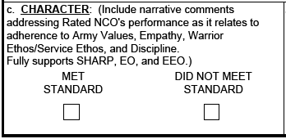
Part IV – CHARACTER
Up to 8 lines of text for each field in Part IV, blocks c through h (ex. Three two-line bullets with a one-line space between them.
Raters must assess the rated NCO’s performance in fostering a climate of dignity and respect and adhering to the requirements of the SHARP Program
Narrative comments will be entered for Part IV, block c on DA Form 2166-9-3 (CSM/SGM)
Notes:
In September 2013, an Army Directive was published mandating all raters to assess how well the rated Soldier fostered a climate of dignity and respect and adhered to the Sexual Harassment/Assault Response and Prevention (SHARP) Program, on their evaluation report.
With the release of the new NCOER and updates to AR 623-3, raters will include their assessment for rated Soldier’s performance in support of SHARP, as well as annotate any substantiated findings found in an Army or DoD Investigation or inquiry, in Part IV, block c.
On DA Forms 2166-9-1 and 2166-9-2, the rater will enter bullet comments addressing the rated NCO’s performance as it relates to adherence to the Army Values, Warrior Ethos / Service Ethos, Discipline, and SHARP/EO/EEO. As mentioned previously, the rater will provide narrative comments for CSM/SGM on DA Form 2166-9-3.
NEXT SLIDE

Slide 21
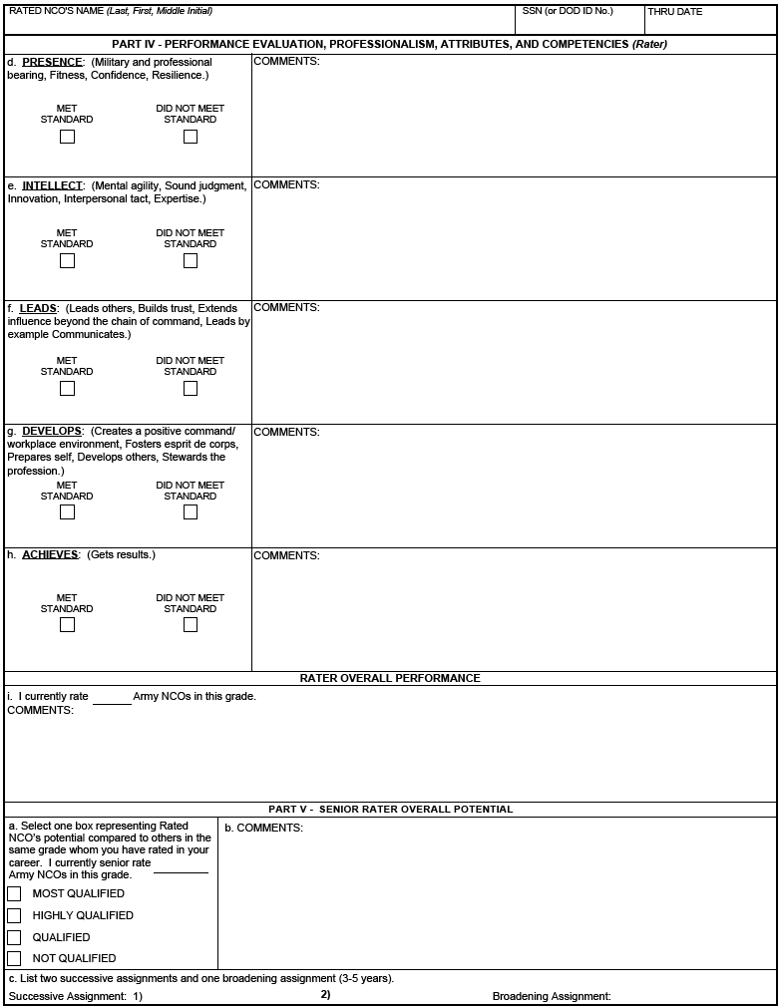
Part IV – Rater Assessment (SGT)
Rater assesses performance using a 2-box scale; focused on technical proficiency and is developmental in nature
“MET STANDARD”
“DID NOT MEET STANDARD”
Rater – bullet comment format
Up to 8 lines of text (bullet format) for each field in Part IV, blocks c through h
Up to 5 lines of text (bullet format)
Notes:
The rater will continue their assessment of the rated NCO’s attributes and competencies on Page 2 using a two-box scale. This NCOER will be focused on technical proficiency and is developmental in nature.
If the rated NCO successfully achieved and maintained the required Army and organizational standards of leader competencies and attributes consistent with the majority of NCOs in that grade of the rater’s population, the rater will place an “X” in the “MET STANDARD” box.
If the rated NCO failed to meet or maintain the required Army standards and organizational goals of leader competencies and attributes and performance was below the majority of NCOs in the that grade of the rater's population, the rater will place an “X” in the “DID NOT MEET STANDARD” box.
Rater comments will remain in bullet format and the rater may enter up to eight lines of text and spacing in Part IV, blocks c through h.
As for the overall performance, the rater will assess the rated NCO’s overall performance compared to other NCOs in that rank/grade. For those who are assessing NCOs in a particular rank for the first time, the rater will use their experience when providing comments.
NEXT SLIDE

Slide 22
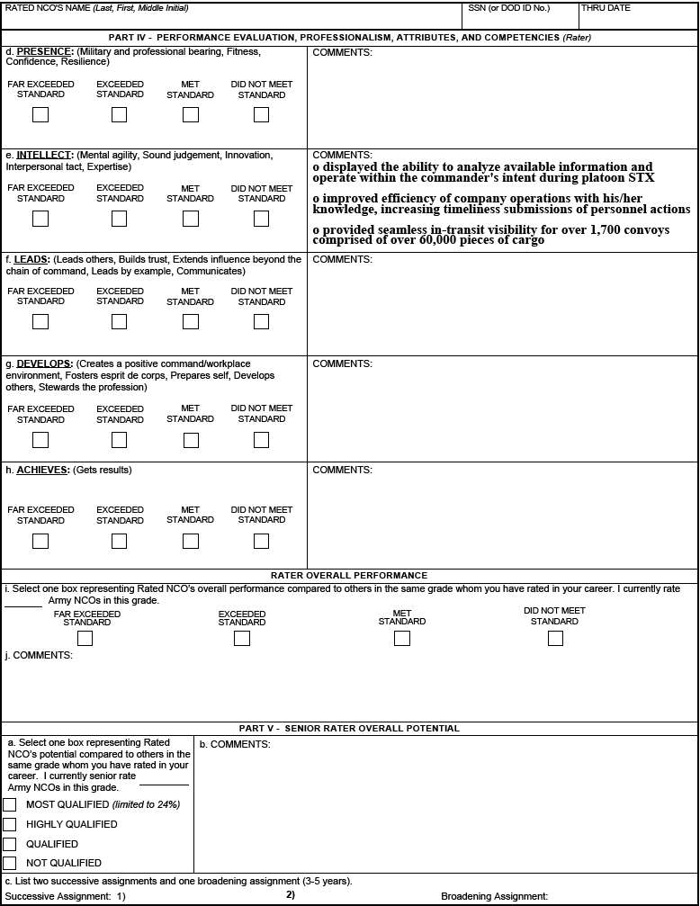
Part IV – Rater Assessment (SSG-1SG/MSG)
Rater assesses performance using a 4-box scale; focused on organizational systems and processes
“Far Exceeded Standard”
“Exceeded Standard”
“Met Standard”
“Did Not Meet Standard”
Rater – bullet comment format
Unconstrained rater overall performance assessment
Up to 8 lines of text (bullet format) for each field in Part IV, blocks c through h
Up to 5 lines of text (bullet format)
Notes:
Whereas the direct-level report for Sergeant uses a 2-box scale, the organizational-level report for Staff Sergeant through First Sergeant / Master Sergeant (SSG-1SG/MSG) uses a 4-box scale which consists of “FAR EXCEEDED STANDARD,” “EXCEEDED STANDARD,” “MET STANDARD,” and “DID NOT MEET STANDARD.”
If the rated NCO’s demonstrated performance surpassed the required Army and organizational standards of leader competencies and attributes of the majority NCOs in that grade of the rater’s population; the rater will place an “X” in either the “EXCEEDED STANDARD” or “FAR EXCEEDED STANDARD” box. The rater will use the “EXCEEDED STANDARD” and “FAR EXCEEDED STANDARD” boxes to identify the upper third of NCOs for each rank, with further stratification of the upper third by use of the “FAR EXCEEDED STANDARD” box. (Note: “FAR EXCEEDED STANDARD” is demonstrated by the best of the upper third of NCOs of the same grade.)
If the rated NCO successfully achieved and maintained the required Army and organizational standards of leader competencies and attributes consistent with the majority of NCOs in that grade of the rater’s population, the rater will place an “X” in the “MET STANDARD” box.
If the rated NCO failed to meet or maintain the required Army standards and organizational goals of leader competencies and attributes and performance was below the majority of NCOs in that grade of the rater's population, the rater will place an “X” in the “DID NOT MEET STANDARD” box.
Rater comments will remain in bullet format and senior rater comments will be in narrative format.
As for the overall performance, the rater will assess the rated NCO’s overall performance compared to other NCOs in that rank/grade using the 4-box scale while providing comments. For those who are assessing NCOs in a particular rank for the first time, the rater will use their experience when providing comments. (Note: If the rater assesses the rated NCO as “DID NOT MEET STANDARD” for any of the attributes or competencies, then the “FAR EXCEEDED STANDARD” and “EXCEEDED STANDARD” selections for the rater overall performance, Part IV, block i (DA Form 2166-9-2) and Part IV, block e (DA Form 2166-9-3) will be grayed out. The rater will only be able to select from “MET STANDARD” or “DID NOT MEET STANDARD.”)
NEXT SLIDE

Slide 23
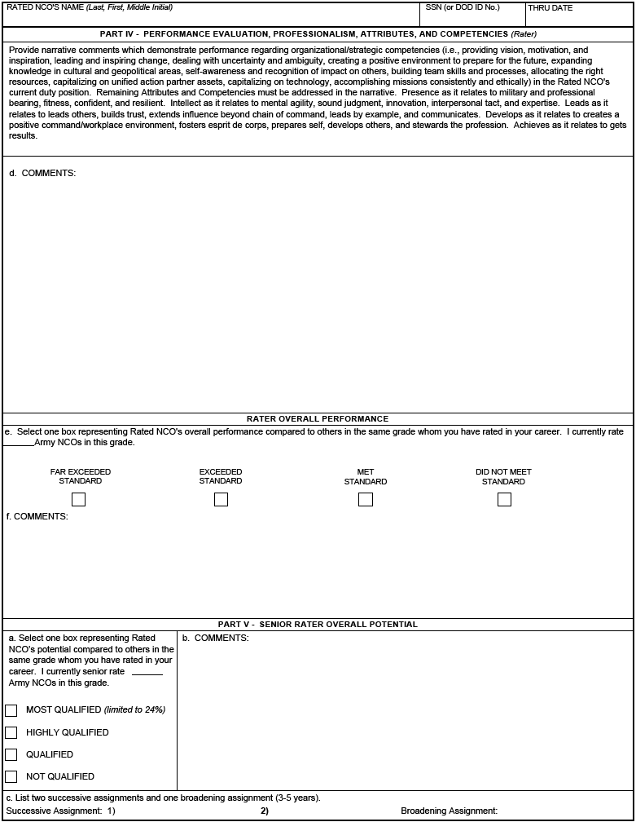
Part IV – Rater Assessment (CSM/SGM)
Performance assessment focused on large organizations and strategic initiatives
Narrative must address each attribute and competency
Unconstrained rater overall performance assessment
Up to 5 lines of text (narrative format)
Up to 4 lines of text (narrative format)
Notes:
The strategic-level report for Command Sergeant Major / Sergeant Major (CSM/SGM) will focus on large organizations and strategic initiatives. It’s similar to the OER in that the rater and senior rater will assess using narrative comments.
The rater’s assessment of overall performance, in Part IV, block e will function the same as the organizational-level report for Staff Sergeant through First Sergeant / Master Sergeant (SSG-1SG/MSG).
NEXT SLIDE

Slide 24
Potential Measures
Limited to 24%
“MOST QUALIFIED” – identify NCOs with strong potential for promotion in the secondary zone; ahead of peers (Note: Senior raters will manage a constrained profile up to 24% for the top block or “MOST QUALIFIED”.)
“HIGHLY QUALIFIED” – identify NCOs with strong potential for promotion with peers
“QUALIFIED” – identify NCOs who demonstrate potential to be successful at the next level; promote if able
“NOT QUALIFIED” – identify NCOs who do not demonstrate potential for promotion; recommend separation
Notes:
For the organizational-level and strategic-level reports, the senior rater will assess the rated NCO’s overall potential during the rating period compared against other NCOs, of the same rank, the senior rater currently senior rates and has senior rated previously.
If the rated NCO’s potential exceeds that of the majority of NCOs in the senior rater’s population, then the senior rater will place an “X” in the “MOST QUALIFIED” box. This box check identifies NCOs with strong potential for promotion in the secondary zone and ahead of peers. In order to maintain a credible profile, the senior rater must have up to 24% of the ratings in a grade to retain the “MOST QUALIFIED” label.
If the rated NCO’s potential is consistent with the majority of NCOs in the senior rater’s population, then the senior rater will place an “X” in the “HIGHLY QUALIFIED” box. This box check identifies NCOs with a strong potential for promotion with peers.
If the rated NCO’s potential is adequate, but beneath the majority of NCOs in the senior rater’s population, then the senior rater will place an “X” in the “QUALIFIED” box. This box check identifies NCOs who demonstrate potential to be successful at the next level, promote if sufficient allocations are available.
If the rated NCO’s potential is below the majority of NCOs in the senior rater’s population, then the senior rater will place an “X” in the “NOT QUALIFIED” box. This box check identifies NCOs who do not demonstrate potential for promotion, recommend separation.
NEXT SLIDE

Slide 25
Part V – Senior Rater Assessment (SGT)
Up to 5 lines of text (narrative format)
Duty title only
Duty title only
Duty title only
Senior rater assessment of rated NCO’s overall potential compared to NCOs in same grade
Unconstrained box check
Narrative comment format
Notes:
The senior rater’s assessment of the rated NCO’s (in the rank of Sergeant and Sergeant Promotable) overall potential will be unconstrained which basically means that there will NOT be a limitation imposed on which box the senior rater may use. Please note that this only applies to the direct-level report for Sergeant. The senior rater will also provide narrative comments to support their box check (“MOST QUALIFIED,” “HIGHLY QUALIFIED,” “QUALIFIED,” “NOT QUALIFIED”) and list two successive assignments and one broadening assignment that the rated NCO can best serve the Army in the future.
The senior rater’s comments will be in narrative format and the rating official may enter up to five lines of text.
NEXT SLIDE

Slide 26
Part V – Senior Rater Assessment (SSG-CSM/SGM)
Up to 5 lines of text (narrative format)
Duty title only
Duty title only
Duty title only
Senior rater assessment of rated NCO’s overall potential compared to NCOs in same grade
Constrained senior rater profile; limited to 24% of total reports
Only one of the first four NCOERs may be rated as “Most Qualified” (“Silver bullet”)
Narrative comment format
Notes:
The senior rater may enter up to five lines of text, in narrative format, in Part V, block b. The senior rater assessment of the rated NCO’s overall potential will be CONSTRAINED and limited to 24% top block or “MOST QUALIFIED.” The “Silver bullet” refers to the senior rater being able to render a top block for any one of the first four reports.
For example, if the senior rater renders a “MOST QUALIFIED” assessment for the first NCOER, then the next seven will have to be either “HIGHLY QUALIFIED,” “QUALIFIED,” or “NOT QUALIFIED.”
The senior rater profile requires the rating official to identify the best talent and reserve the top block assessment for those who are truly deserving. While the box check is important, the senior rater’s narrative comments are just as significant. The narrative comments should quantify and/or support the box check.
In Part V, block c, the senior rater will list two successive assignments and one broadening assignment, by duty title only, that the rated NCO can best serve the Army in the future.
NEXT SLIDE

Slide 27
Summary
What is Changing on the NCOER
NCOER Support Form
Grade Plate NCOER
Part I – Administrative Data
Part II – Authentication
Part III – Duty Description
Parts IVa and IVb – APFT and HT / WT
Army Leadership
Performance Measures
“FAR EXCEEDED STANDARD”
“EXCEEDED STANDARD”
“MET STANDARD”
“DID NOT MEET STANDARD”
Notes:
To recap Module 3 – Grade Plate Forms, we covered the following key areas:
What is changing on the NCOER
The 2166-9 Series Forms and the parts of each form
The leader attributes and competencies and how the Leadership Requirements Model is linked to the three reports
NEXT SLIDE

Slide 28
Summary (cont.)
Part IV – Rater Assessment
Character
Direct-level Report (SGT)
Organizational-level Report (SSG-1SG/MSG)
Strategic-level Report (CSM/SGM)
Potential Measures
“MOST QUALIFIED”
“HIGHLY QUALIFIED”
“QUALIFIED”
“NOT QUALIFIED”
Part V – Senior Rater Assessment
Direct-level Report (SGT)
Organizational- and Strategic-level Reports (SSG through CSM/SGM)
Notes:
In addition, we covered the rater and senior rater’s assessment for each form and the NCOER Support Form.
NEXT SLIDE

Slide 29
Questions
Notes:
Subject to your questions, this concludes my brief of Module 3.

