Slide 1
Revised Noncommissioned Officer Evaluation Reporting System
Module 1: Overview
as of 10 July 2015
Notes:
Good morning/afternoon. My name is __________. I’m the __________ at ________________. Today I’m going to provide you an overview of the revised Noncommissioned Officer Evaluation Reporting System. Please note that modules two through four will provide in-depth information concerning the updated policy changes, the NCOER Support Form and three grade plate NCOERs, and profile management.
NEXT SLIDE

Slide 2
Agenda
Background
Approved Changes
NCOER Support Form and Grade Plate NCOERs
Rater Tendency Label
Senior Rater Profile Label
Notes:
The agenda for Module 1 will cover the following:
Background
Approved changes to the New NCOER
NCOER Support Form and the three grade plate NCOERs
Rater Tendency Label, and
Senior Rater Profile Label
NEXT SLIDE

Slide 3
Background
Key Focus of the Evaluation Reporting System Review:
Reflect current leadership doctrine (ADP 6-22)
Establish and enforce rating official accountability
Address the “one-size-fits-all”
Development Process:
Current NCOER implemented in 1987
Proposed changes based on the following:
38th CSA Strategic Priorities
DA Centralized Selection Board comments
Field input
Lessons learned during fielding of OER
Mirrors development of OER with modification by Army Leaders
Informed By:
SECARMY Guidance
38th CSA reshaping and approval
SMA, Board of Directors, and NCO Working Groups
Other Services and Industry review
HQDA Centralized Selection Board AARs
General Officer Steering Committee / Council of Colonels
ADP 6-0 and ADP 6-22
Profession of Arms Forum
Army White Paper, The Profession of Arms
Army Leader Development Strategy
NCOER remains the primary tool documenting NCO performance and potential
Notes:
To give you some background on the New NCOER, it began in 2010 when the Chief of Staff of the Army directed a review of the Evaluation Reporting System. As it related to the NCOER, there were three key areas that Army leadership wanted to focus on.
First, aligning the NCOER with current leadership doctrine. The current NCOER that the Army uses has been in place since 1987, it is outdated and has not adapted to changes in doctrine or the expectations of our Army and NCO Corps over time.
Second, Army leadership wanted to focus on establishing and enforcing rating official accountability. This was aimed primarily at eliminating inflation in the system.
Third, was determining if the “one-size-fits-all” approach was still appropriate in today’s Army and NCO Corps. The “one-size-fits-all” pertains to one report for all NCOs regardless of rank, position, and/or responsibility.
Based on the CSA’s guidance, the Sergeant Major of the Army, his Board of Directors, and NCO working groups reviewed the process and made recommendations that were then validated by a Council of Colonels and General Officer Steering Committee in June 2012. Army leadership then directed HRC to gather Army-wide feedback on the recommended changes, review DA Centralized Selection Board AAR comments, and identify lessons learned from fielding the revised OER.
Building on the initial proposal, the final recommendations were presented to the SMA in April 2014 and approved by the CSA and SECARMY on 1 August 2014. As noted in the CSA’s Strategic Priorities, GEN Odierno identified the need for instituting new evaluation and assessment tools that enable Army leaders to more clearly identify the best talent and encourage leaders to seek self-improvement which shaped the following approved changes.
Note 1: Over the last four years, Human Resources Command has completed coordination with TRADOC and FORSCOM, Center for Army Leadership, and the Sergeant Major of the Army and his Board of Directors (BOD) in addition to receiving input from all levels of the Army.
Note 2: The SECARMY recently approved a change to the senior rater profile (limited to 24%) on 10 June 2015. As SMA Dailey noted to the field, this will ensure NCOs will remain competitive for promotion with “HIGHLY QUALIFIED” NCOERs, given they complete their required professional military education.
NEXT SLIDE

Slide 4
Approved Changes
Applicable to all Army components (Regular Army, Reserve, and Guard)
Three NCOER forms aligned with Army Leadership Doctrine (ADP 6-22)
SGT (Direct)
SSG-1SG/MSG (Organizational)
CSM/SGM (Strategic)
Rater tendency for Raters of SSG-CSM/SGM
Senior rater profile for senior raters of SSG-CSM/SGM; limited to 24% for the “MOST QUALIFIED” selection
Clear delineation of rating official roles & responsibilities
Rater assesses performance
Senior Rater assesses potential
Notes:
Based on the development process during the past four years and the recommendations presented to Army Leadership, the Secretary of the Army approved the following key changes that will apply to all Army components (Regular Army, Reserve, and Guard):
First, we will transition from one NCOER to three forms based on grade plate. This recognizes the differences between junior and senior NCOs while allowing assessments to focus on grade-specific technical performance objectives. In addition, the New NCOER aligns with current doctrine by capturing the attributes and competencies from Army Doctrine Publication (ADP) 6-22, Army Leadership. As for the three reports, the direct-level report for Sergeant (SGT) will focus on proficiency and is developmental in nature. The organizational-level report for Staff Sergeant through First Sergeant / Master Sergeant (SSG-1SG/MSG) will focus on organizational systems and processes. The strategic-level report for Command Sergeant Major / Sergeant Major (CSM/SGM) will focus on large organizations and strategic initiatives.
Second, to achieve rating chain accountability, we will implement a rater tendency for the ranks of Staff Sergeant through Command Sergeant Major / Sergeant Major (SSG-CSM/SGM). For raters, there will not be a limitation to the rater’s assessment of overall performance. You can assess as you see fit. Your rater and senior rater will be able to see your tendency or rating history when viewing your support form – I will show you more about that later.
Third, we will implement a senior rater profile for the ranks of Staff Sergeant through Command Sergeant Major / Sergeant Major (SSG-CSM/SGM). The senior rater profile for the New NCOER will be limited to 24% top block or “MOST QUALIFIED” selection. This change in senior rater accountability will eliminate inflation, clearly identify the best, and help in the selection board process.
Fourth, there will be a separation (delineation) of rating official roles and responsibilities – raters will focus only on performance, while senior raters will address potential. This separation will allow rating officials to focus on a specific area while eliminating the inconsistent ratings that we sometimes have with the current NCOER. It also eliminates the need for a reviewer as we know it.
NEXT SLIDE

Slide 5
Approved Changes
Assessment Format
Rater
Bullet comments (SGT-1SG/MSG)
Narrative comments (CSM/SGM)
Senior rater – narrative comments for all NCOs
Supplementary reviewer required when the senior rater is a 2LT-1LT, WO1-CW2, or SFC-1SG/MSG; in certain situations (i.e., no uniformed Army-designated rating officials, senior rater or someone outside the rating chain directs relief)
NCOER Support Form aligned with Army Doctrine (ADP 6-22)
New senior rater comments box
Senior rater should counsel at least twice during rating period
Discourage creation of large senior rater populations (pooling)
Notes:
Fifth, we are updating how rating officials assess. Raters for Sergeant through First Sergeant/Master Sergeant (SGT-1SG/MSG) will continue to assess in bullet comment format. However, raters for Command Sergeant Major/Sergeant Major (CSM/SGM) and senior raters for all ranks will assess in narrative comment format.
For the New NCOER, the senior rater will have the primary responsibility to ensure the evaluation meets all regulatory requirements and policies. To ensure proper oversight for senior raters who may be inexperienced and/or unfamiliar with managing a senior rater profile and writing narrative comments, a supplementary review will be required for all NCOERs when the senior rater is a 2LT-1LT, WO1-CW2, or SFC-1SG/MSG. The supplementary reviewer requirement will also be used when there are no uniformed Army-designated rating officials (i.e., all civilians or sister services) within the rating chain and when the senior rater or someone outside the rating chain directs a “Relief for Cause” report.
Another key change includes a section on the New NCOER Support Form which will allow the senior rater to provide comments based on his/her counseling sessions with the rated NCO. This will complement the rater’s initial and quarterly counseling requirement. Moreover, with the approved use of a senior rater profile, it will be even more critical for the senior rater to provide counsel and mentorship to the rated NCO.
Like the OER, and to ensure rating schemes are established in accordance with the regulation, “pooling” or elevating the rating chain beyond the senior rater’s ability to have adequate knowledge of each NCO’s performance and potential, in order to provide an elevated assessment for a specific group, is prohibited. As a reminder, rating schemes should be as follows: the rated NCO’s immediate supervisor is the rater and the rater’s supervisor is the senior rater. Rating schemes based on pooling erode Soldiers’ confidence in the fairness and equity of the Evaluation Reporting System and in their leaders.
All of these approved revisions, in particular the senior rater profile and narrative format, will create a significant culture change in how the Army assesses NCOs. With that in mind, it is crucial that all rating officials and NCOs at every level fully understand the new assessment tools and policy changes in order to identify the best talent in today’s Army and support the Chief of Staff’s Strategic Priorities.
NEXT SLIDE

Slide 6
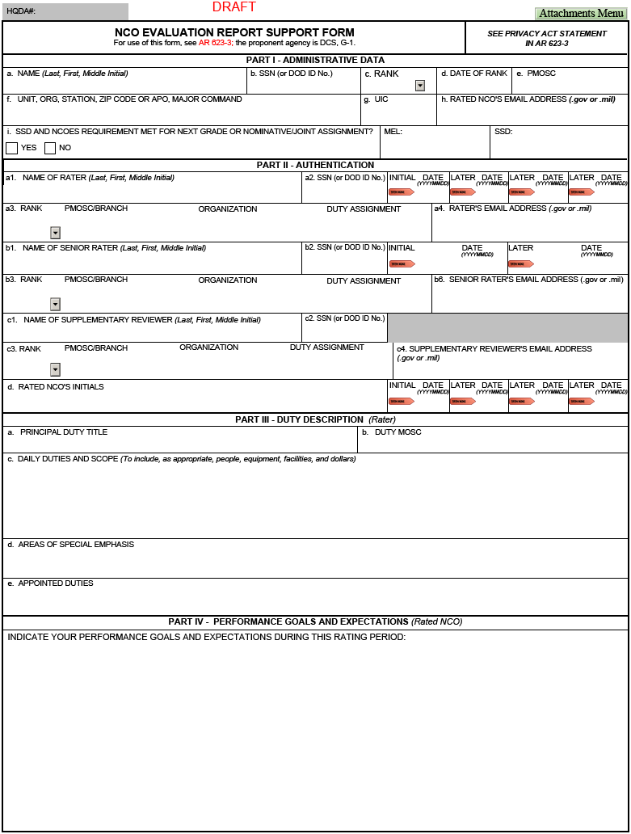
NCOER Support Form – Page 1
Part I – SSD and NCOES requirement met for next grade
Part II – Senior rater annotates counseling dates
Part II – Supplementary reviewer, if required
Part IV – Rated NCO provides goals and expectations
Notes:
The next couple of slides are snapshots of the NCOER Support Form and the three grade plate NCOERs.
The NCOER Support Form includes the following new features:
In Part I, the Structured Self-Development (SSD) and Military Education Level (MEL) codes will be entered on the form. This will allow the rating chain to mentor and counsel the rated NCO and track his/her progress in attaining promotion eligibility for the next grade (in the case of Sergeants Major, eligibility for joint and/or nominative assignments).
In Part II, the senior rater will provide his/her counseling dates in addition to the rater’s.
If a supplementary review is required, then Part II, blocks c1 through c4 will be completed along with the rater’s and senior rater’s sections at the beginning of the rating period.
In Part IV, the rated NCO will list his/her goals and expectations. This change gives the rated NCO input about goals and expectations but will also place more onus or responsibility on the rated NCO to perform throughout the rating period. The information provided gives the rating officials additional information to consider when evaluating overall performance and potential at the end of the rating period.
NEXT SLIDE

Slide 7
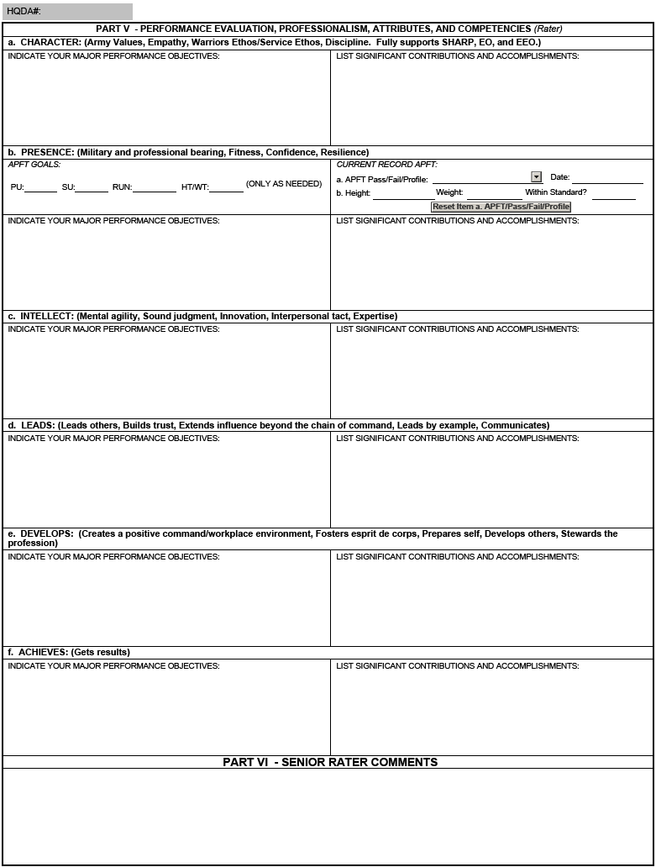
NCOER Support Form – Page 2
Part V – Attributes and Competencies (ADP 6-22)
Part VI – Senior rater provides comments
Notes:
In Part V, in the left column, the rater will identify the major performance objectives based on the attributes and competencies listed in ADP 6-22. In the right column, the rater and rated NCO can list significant contributions and accomplishments – these notes can help provide the basis for the NCOER itself.
In Part VI, the senior rater will be able to provide comments based on counseling sessions conducted with the rated NCO.
NEXT SLIDE

Slide 8
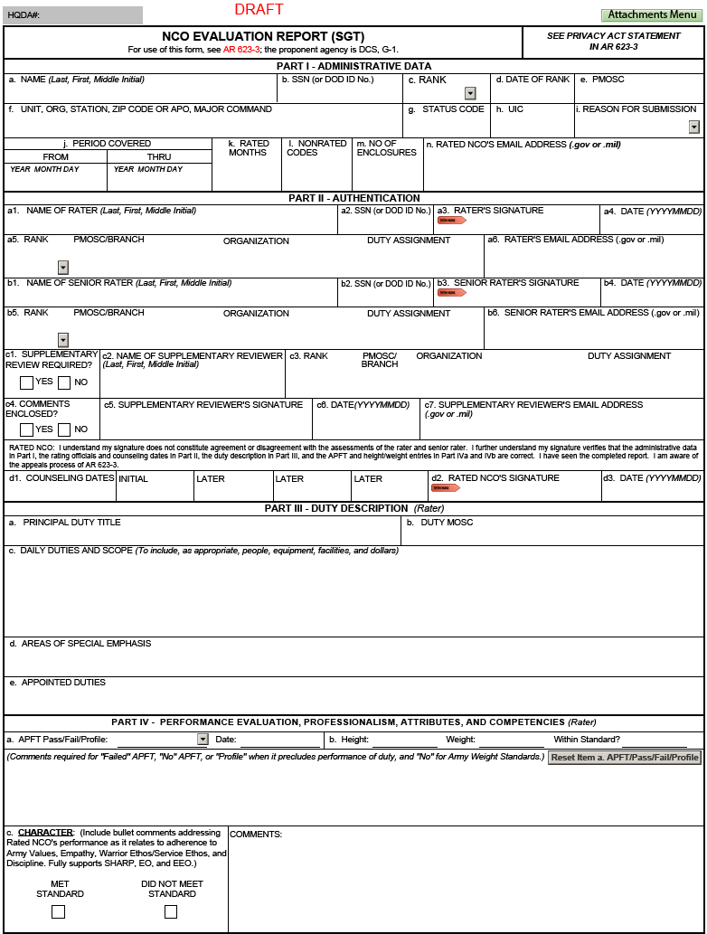
DA Form 2166-9 Series Front Page
Administrative data is the same for all reports
Supplementary reviewer required when the senior rater is a 2LT-1LT, WO1-CW2, or SFC-1SG/MSG; and in certain situations
Part II, block d2 – Rated NCO’s signature verifies seeing the report and the accuracy of administrative data in Part I, rating chain and counseling dates in Part II, duty description in Part III, and APFT and HT/WT data in Part IV
Part IV
Bullet comments for Direct- and Organizational-level reports
Narrative comments for Strategic-level report
Notes:
As for the front page of the NCOER, the format will be the same for all three grade plate forms.
In Part II, if the supplementary review is not required, then the rating official(s) will check “NO” in Part II, block c1 and leave the remaining section blank. If the supplementary review is required, recommend identifying that individual at the beginning of the rating period.
Also in Part II, there is room to show counseling dates and the rated NCO’s signature. The signature will be applied by the rated NCO at the end of the rating period when reviewing the completed report.
Part III contains the duty description, duty MOS, areas of special emphasis, and appointed duties.
In Part IV, the rater will begin assessing the rated NCO. The only difference in Part IV is for the strategic-level report which will be in narrative format. The other two grade plate forms will be in bullet format.
NEXT SLIDE

Slide 9
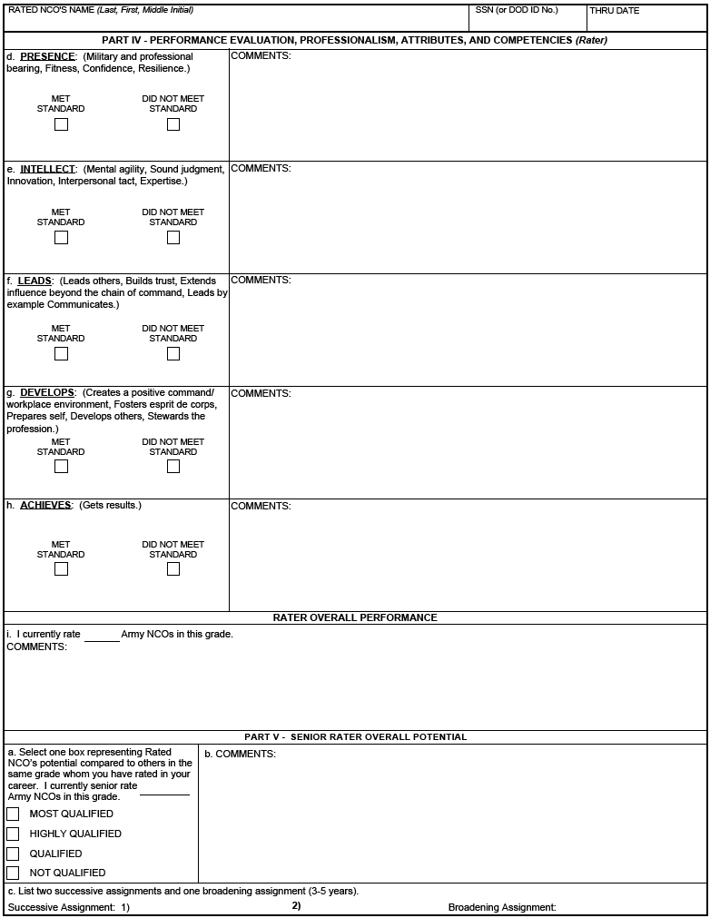
Direct-level Report (SGT) – Page 2
Focuses on proficiency and is developmental in nature; aligns with Army Leadership Doctrine
Assessment based on 2-box scale
“MET STANDARD”
“DID NOT MEET STANDARD”
Rater – bullet format
Unconstrained senior rater box check
Senior rater – narrative format
Notes:
For the direct-level report, raters will assess Sergeants (SGTs) using a 2-box scale (“MET STANDARD” and “DID NOT MEET STANDARD”). “MET STANDARD” denotes an NCO who successfully achieves and maintains required Army and organizational standards. “DID NOT MEET STANDARD” identifies an NCO who did not meet Army and organizational standards. As noted previously, this grade plate form will be focused on technical proficiency and is developmental in nature.
Rater comments will remain in bullet format.
As for the overall performance, the rater will assess the rated NCO’s overall performance compared to other NCOs in that rank/grade. For those who are assessing NCOs in a particular rank for the first time, the rater will use his/her experience when providing comments.
The senior rater’s assessment of the rated NCO’s overall potential will be unconstrained which basically means that there will not be a limitation imposed. Please note that this only applies to the direct-level report for Sergeant. The senior rater will also provide narrative comments to support his/her box check (“MOST QUALIFIED,” “HIGHLY QUALIFIED,” “QUALIFIED,” “NOT QUALIFIED”) and list two successive assignments and one broadening assignment that the rated NCO can best serve the Army in the future.
NEXT SLIDE

Slide 10
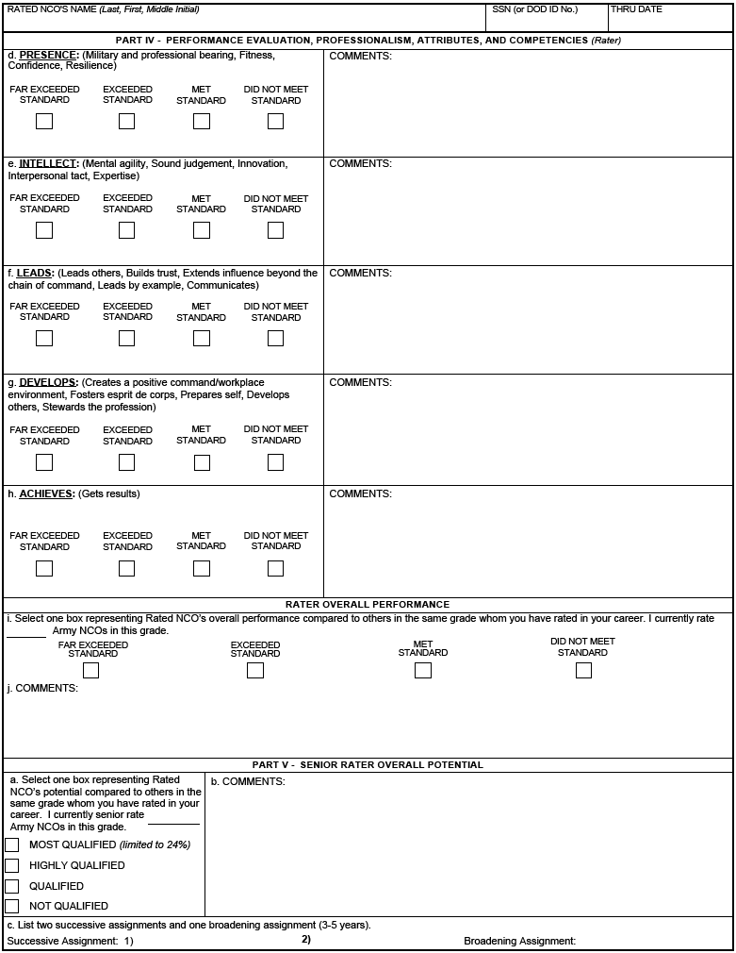
Organizational-level Report (SSG-1SG/MSG) – Page 2
Focuses on organizational systems and processes; aligns with Army Leadership Doctrine
Rater – bullet format
Assessment based on 4-box scale
“FAR EXCEEDED STANDARD”
“EXCEEDED STANDARD”
“MET STANDARD”
“DID NOT MEET STANDARD”
Unconstrained Rater Tendency
Senior rater profile is limited to 24% for “MOST QUALIFIED” selection; no credit applied – only one of the first four reports may be “MOST QUALIFIED”
Senior rater – narrative format
Notes:
Whereas the direct-level report for Sergeant uses a 2-box scale, the organizational-level report for Staff Sergeant through First Sergeant / Master Sergeant (SSG-1SG/MSG) uses a 4-box scale (“FAR EXCEEDED STANDARD,” “EXCEEDED STANDARD,” “MET STANDARD,” “DID NOT MEET STANDARD”). High level definitions for these boxes are contained in later briefings. This NCOER will focus on organizational systems and processes.
Rater comments will remain in bullet format.
As for the rater’s assessment of overall performance, the rater will assess the rated NCO’s overall performance compared to other NCOs in that rank/grade using the 4-box scale while providing comments. For those who are assessing NCOs in a particular rank for the first time, the rater will use his/her experience when providing comments. The rater is not limited in which box they choose but the rating history, also known as a Rater Tendency, will overprint on the NCOER and will be visible to the rater’s rating chain.
The senior rater assessment of the rated NCO’s overall potential will be limited to 24% top block or “MOST QUALIFIED” selection. The term “Silver bullet” refers to the senior rater being able to render a top block for any one of the first four reports. For example, if the senior rater renders a “MOST QUALIFIED” for the first NCOER, then the next seven will have to be either “HIGHLY QUALIFIED,” “QUALIFIED,” or “NOT QUALIFIED.” The senior rater profile requires the rating official to identify the best talent and reserve the top block assessment for those who are truly deserving. While the box check is important, the senior rater’s narrative comments are just as significant. The narrative comments should quantify and support the box check. During Module 4, you’ll receive detailed information on profiling, writing style, etc.
(Note: No credit will be applied to the senior rater profile so everyone will start from zero (0). This will require all senior raters to identify the best talent and closely manage their profile thereby eliminating inflation.)
The senior rater will also list two successive assignments and one broadening assignment that the rated NCO can best serve the Army in the future.
NEXT SLIDE

Slide 11
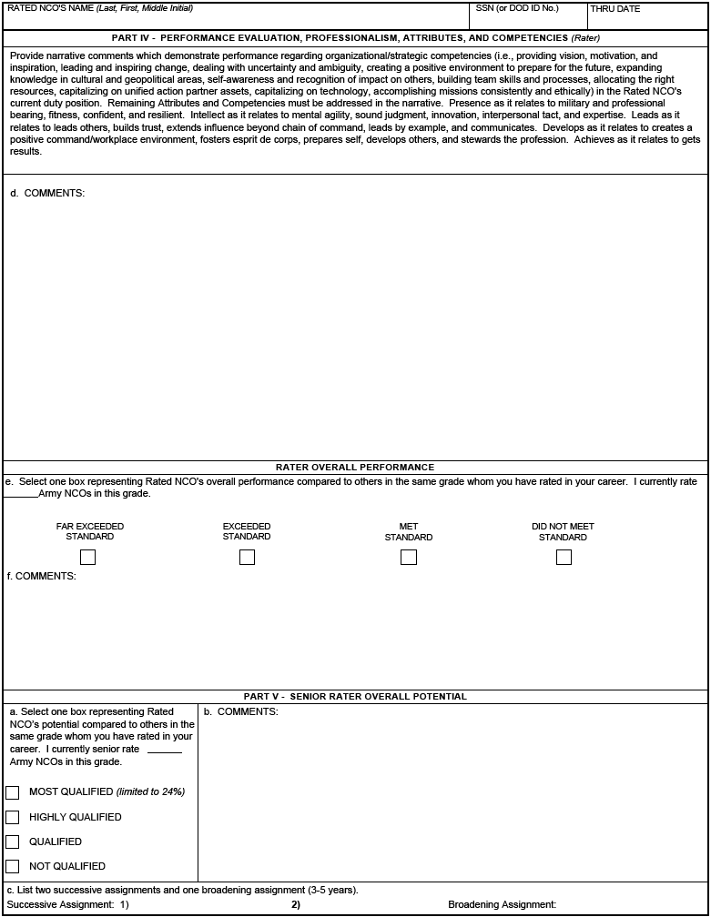
Strategic-level Report (CSM/SGM) – Page 2
Focuses on large organizations and strategic initiatives; aligns with Army Leadership Doctrine
Rater – narrative format
Rater overall performance is not limited
Senior rater profile is limited to 24% for “MOST QUALIFIED” selection; no credit applied – only one of the first four reports may be “MOST QUALIFIED”
Senior rater – narrative format
Notes:
The strategic-level report for Command Sergeant Major / Sergeant Major (CSM/SGM) will focus on large organizations and strategic initiatives. It’s similar to the OER in that the rater and senior rater will assess using narrative comment format.
The rater’s assessment of overall performance and the senior rater’s assessment of overall potential will function the same as the organizational-level report for Staff Sergeant through First Sergeant / Master Sergeant (SSG-1SG/MSG).
NEXT SLIDE

Slide 12
Rater Tendency Label
(applies to SSG-CSM/SGM)
2 3 6 1 Total Ratings: 12
Note: This is the rater’s “capstone” assessment of performance and opportunity to “stratify / quantify.”
Key information includes the following:
Rater tendency (i.e., rating history) – the value below each box equals the overall history of those ratings in this grade
Rater tendency label will be imprinted on the NCOER and viewable within the Evaluation Entry System (EES) by the rater’s rater and senior rater
Notes:
The rater tendency label depicts the rater’s overall rating history in a particular grade. The example shows that the rater rendered 12 ratings for Sergeant First Class. Of those 12, the rater identified two (2) as “FAR EXCEEDED STANDARD,” three (3) as “EXCEEDED STANDARD,” six (6) as “MET STANDARD,” and one (1) as “DID NOT MEET STANDARD.” Because the rater tendency is unconstrained (i.e., no limitation), it is imperative that the rater maintain a credible rating history. In the event the rater tendency reflects inflation (for example, out of 12 total ratings, eight (8) are either “FAR EXCEEDED STANDARD” or “EXCEEDED STANDARD”), then there is the potential for the rater’s credibility to be questioned when reviewed by a DA Centralized Selection Board and/or the rater’s rating chain.
When selection board members view the Rater Overall Performance section, they will see the performance box check, the rater’s tendency, and comments quantifying/qualifying the box check.
An additional feature within the Evaluation Entry System (EES) is the ability for the rater’s rater and senior rater to view the rater’s rater tendency. This will allow the rater’s rating chain to provide oversight and guidance to ensure the rater is managing his/her rater tendency in accordance with Army guidance.
It is also important to note that the rater’s rater and senior rater will have visibility of the rater’s tendency report. Leaders are responsible for developing, mentoring, and counseling raters in order to discourage inflation and protect a rater’s credibility.
NEXT SLIDE

Slide 13
Senior Rater Profile Label
(applies to SSG-CSM/SGM)
HQDA COMPARISON OF THE SENIOR RATER’S PROFILE AT THE TIME THIS REPORT PROCESSED
HIGHLY QUALIFIED
RNCO: SMITH, BOB
SR: DODD, JANE
DATE: 2017-05-01
TOTAL RATINGS: 3
RATINGS THIS NCO: 1
Key information includes the following:
Senior rater’s profiled assessment of rated NCO’s potential
Senior rater’s total number of ratings
Number of ratings for the rated NCO by the current senior rater
Notes:
The senior rater assessment of the rated NCO’s overall potential will be CONSTRAINED and limited to 24% top block or “MOST QUALIFIED.” There will be no credits given to senior raters. However, senior raters will be able to use a “Silver bullet” which refers to the senior rater being able to render a top block for any one of the first four reports for a particular grade (SSG through CSM/SGM). For example, if the senior rater renders a “MOST QUALIFIED” for the first NCOER, then the next seven will have to be either “HIGHLY QUALIFIED,” “QUALIFIED,” or “NOT QUALIFIED.” The senior rater profile requires the rating official to identify the best talent and reserve the top block assessment for those who are truly deserving. While the box check is important, the senior rater’s narrative comments are critical because they amplify the box check and the NCO’s future potential. The narrative comments are critical and should quantify and/or support the box check.
Once processed at HQDA, the senior rater profile label will be applied to the completed NCOER. It will show the following:
Rated NCO’s name
Senior rater’s name
Date received at HRC
Total number of ratings rendered by the senior rater for that rank/grade
Total number of ratings for this NCO
NEXT SLIDE

Slide 14
Summary
Background
Approved Changes
NCOER Support Form and Grade Plate NCOERs
Rater Tendency Label
Senior Rater Profile Label
Notes:
Just to recap Module 1, we covered the New NCOER background and development process, approved changes, the NCOER Support Form and three grade plate NCOERs, Rater Tendency Label, and the Senior Rater Profile Label. As a reminder, we’ll address the following modules with you:
Module 2 will cover all of the new evaluation policy changes.
Module 3 will provide an in-depth review of the NCOER Support Form, three grade plate NCOERs, and the attributes and competencies of ADP 6-22.
Module 4 will address profiling, which includes the roles and responsibilities of the rating chain, Rater Overall Performance, Senior Rater Overall Potential, and the Evaluation Entry System tools.
NEXT SLIDE

Slide 15
Questions
Notes:
Subject to your questions, this concludes my brief of Module 1.

